Slide 1

Course Scheduler
Team 1: CS 442 Mobile App Development

Slide 2
Meet the team: Brief overview
Markiyan Varhola (CS) : Layouts n Activities N Critical Debugger
Fatima Azfar (CS) : Data collection N Documentation
Srajan R S (CS) : Team Management n UI beautification N Security
Jiarui Jang (CS) : Data manager N Search Display

Slide 3
Why a Course Scheduler?
Students complain of the difficulty of signing up for classes.
Freshmen students get lost getting to their classes early on
Many different resources; My.iit, degreeworks, week at a glance, class bulletin, etc.
Inefficient to go back & Forth between different resources.
Students miss out on possible opportunities (class timing, schedule with friends, etc)

Slide 4
Solution: Course Scheduler app
Consolidate resources into one location
A password secure mobile application
create a semester schedule on the spot
view details about a course
course times, prof name, and description
view locations of your scheduled classes on an easy-to-navigate google maps interface

Slide 5
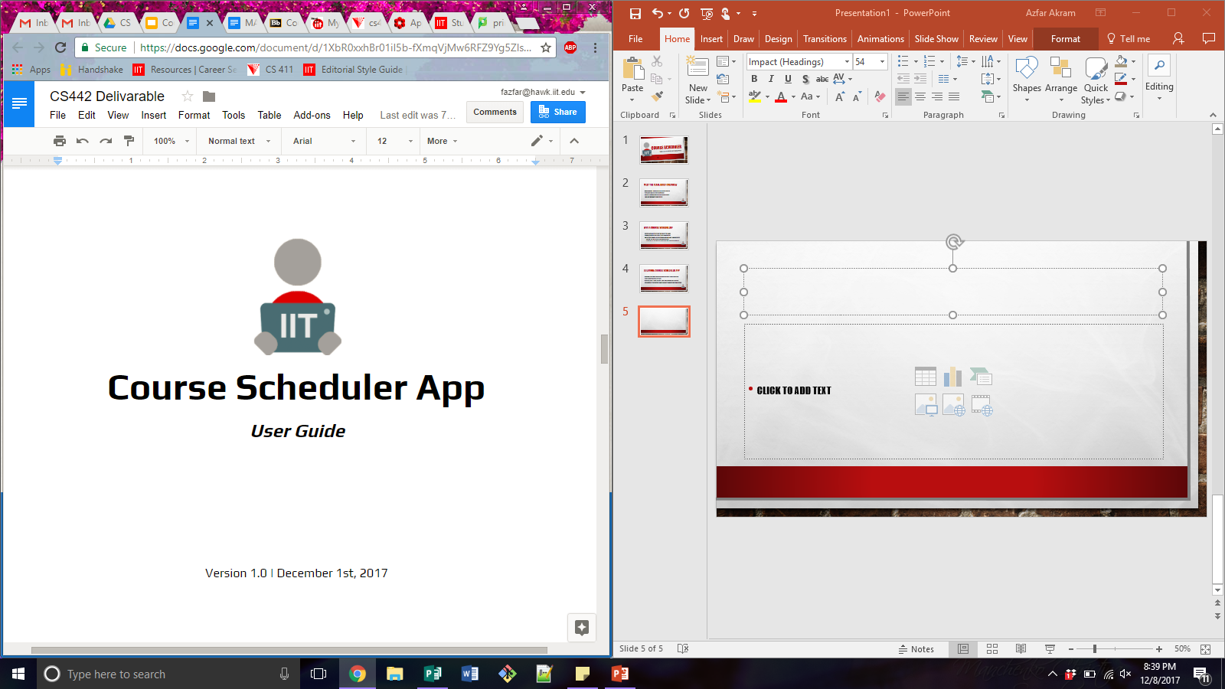
Brief overview. Detailed user guide available for perusal.

Slide 6
table of contents:
1 Introduction
2 Installation and Login
3 Application Usage Overview
4 Specific Case Usage
5 Courses
6 Demo
7 Contact Us
8 Data Source
9 Questions about the Course Scheduler
10 About this User Guide

Slide 7
1 Introduction
The Course Scheduler App has been created in order to aid your course application and scheduling process, making it a more efficient and organized task. After installing the Android mobile Course Scheduler Application, you will have the ability to:
Login or sign up to a personal student account
Review a list of all undergraduate Computer Science courses
Review detailed information for each of the courses in the list
Add and remove courses from a schedule
Add a location on campus to a course
View all locations for courses on an integrated google map’s service

Slide 8

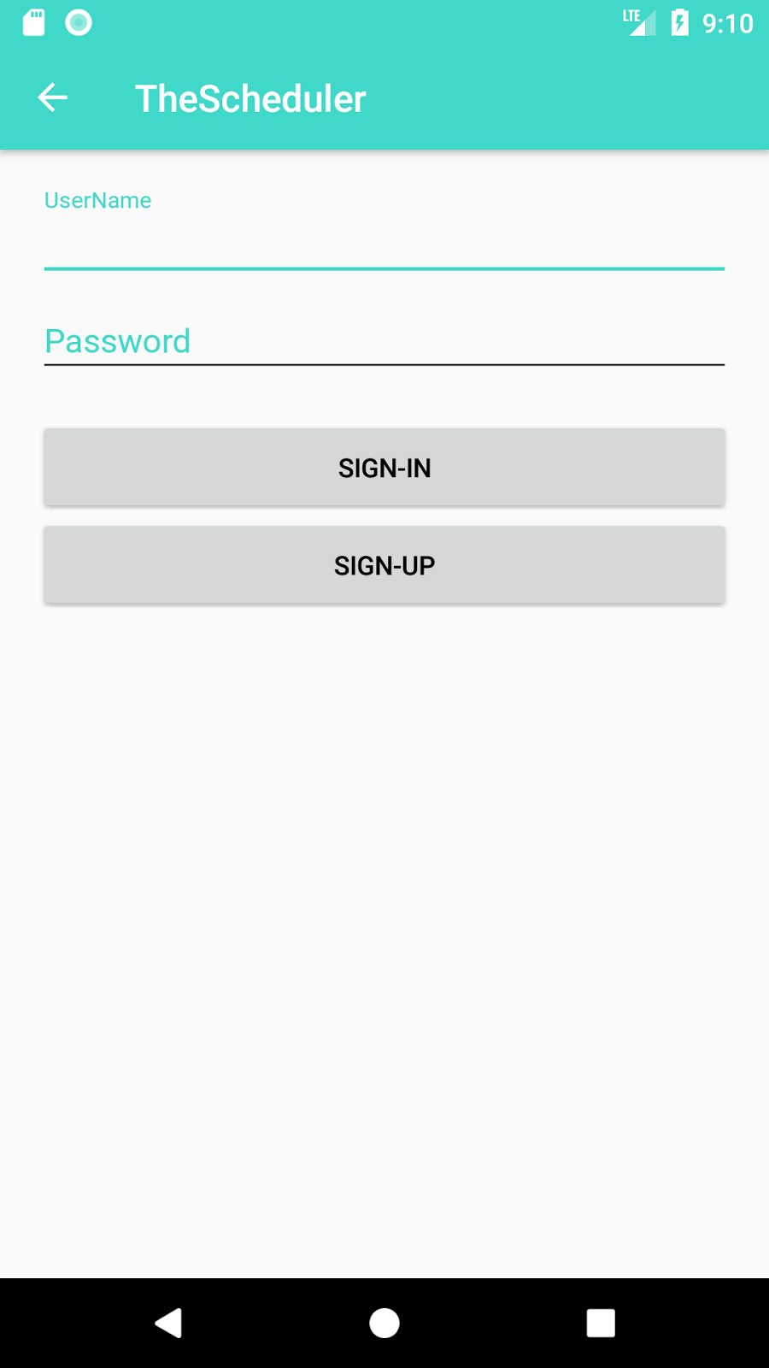
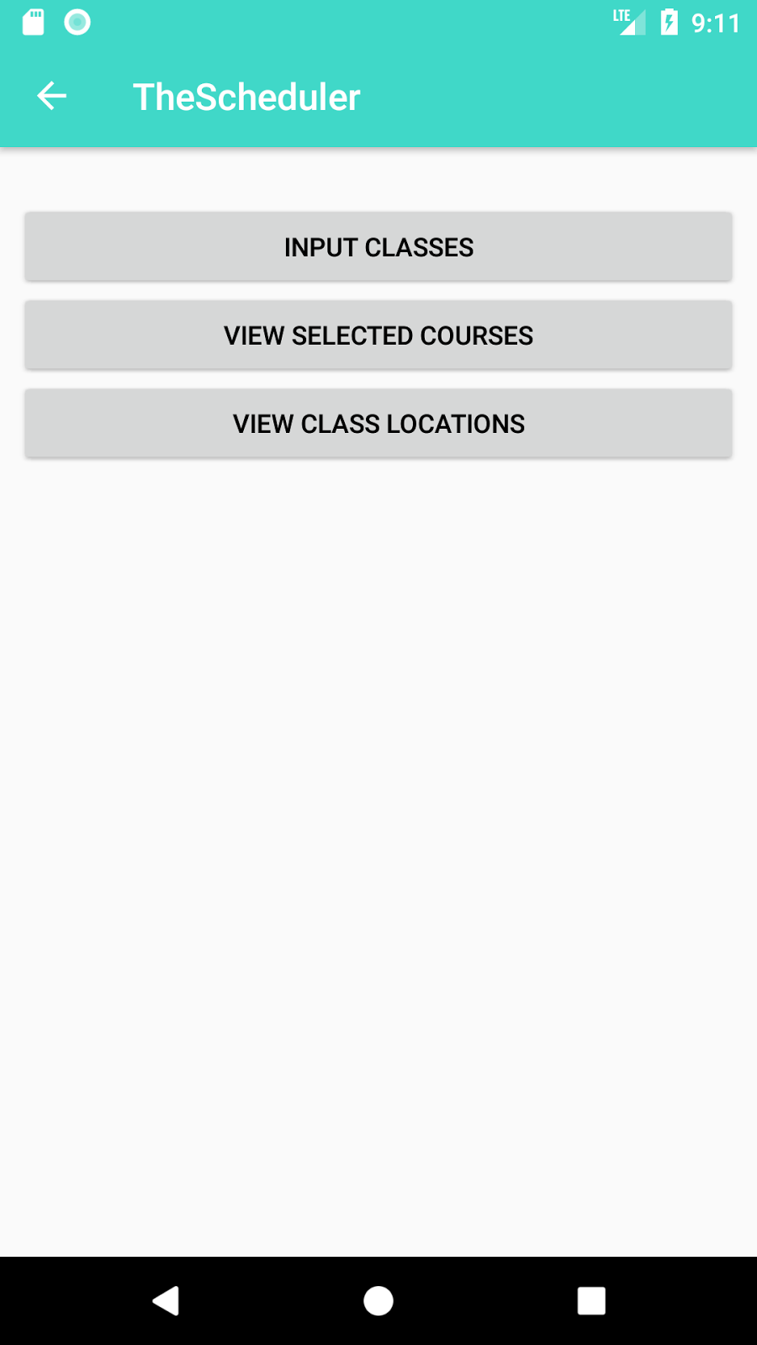
3 Application usage & Overview
Once logged in, you will be able to see a dashboard screen. You can access several Course Scheduler Android Mobile App options from the dashboard. From this page you can:
Access the List of Classes to input in your schedule via “Input Classes” button
Access schedule via “View Selected Courses” button
Access Google Maps view of locations of selected course via “View Class Location”
Go Back to Login page by clicking back arrow on the top left corner of the page, or by using the Android built-in back button on the bottom left corner.

Slide 9
7 Contact us
For questions or concerns, contact the developers of this app at their respective emails below.
Markiyan Varhola: mvarhola@hawk.iit.edu
Fatima Azfar: fazfar@hawk.iit.edu
Srajan R S: srajendrasurekha@hawk.iit.edu
Jiarui Jiang: jjiang28@hawk.iit.edu

Slide 10
10 About this user guide
Course Scheduler App Logo is property of CS442 Team 1. Pay our tuition to use it. ©2017
Currently, the Course Scheduler App is prioritized for computer science students at Illinois Institute of Technology. If you are not a current Illinois Tech Computer Science student, you will not be able to enjoy this application in its fullest potential.

Slide 11
Demo and Q&A
let the demo begin

